Slide 1
Chapter 4
Ch.101
Semister 1 (2016-2017)
Term Symboles
Lecturers:
1- Dr. Majeed Y. Y. Al-Luaibi
2- Dr. Faris A. J. Aldoghachi

Slide 2
1s, 2s, 2p, 3s, 3p, 4s, 3d, 4p, 5s, 4d, 5p, 6s, 4f, 5d, 6p, 7s, 5f, 6d

Slide 3
Example:
Applying the aufbau principle construct energy level diagram and the threshold representation of the G.S. configuration of aluminium, provide one set of valid quantum numbers for the highest-energy electron.
Placing the last electron in the " middle " 3p orbital is an orbitrary choice because these three orbitals are degenerate. Likewise the final electron could be given either spin orientation.
The shorthand configuration is 1s²2s²2p⁶3s²3p¹
The highest energy electron is a (3p) orbital, meaning
n=3 ; l=1 ; m_{l}=(+1, 0, -1) ; m_{s}could be +1/2 or -1/2
Thus six possible sets.

Slide 4
He ( 2 electrons) 1s² [He]
Ne (10 electrons) [He] 2s² 2p⁶ [Ne]
Ar (18 electrons) [Ne] 3s² 3p⁶ [Ar]
Kr (36 electrons) [Ar] 4s² 3d¹⁰ 4p⁶ [Kr]
Xe (54 electrons) [Kr] 5s² 4d¹⁰ 5p⁶ [Xe]
Rn (86 electrons) [Xe] 6s² 5d¹⁰ 4f¹⁴ 6p⁶ [Rn]
Example:
What is the ground state configuration of Bismuth, Z=83 ? specify quantum numbers of any unpaired electrons.
For the 83 electrons of the Bismuth
{1s², 2s², 2p⁶, 3s², 3p⁶, 4s², 3d¹⁰, 4p⁶, 5s², 4d¹⁰, 5p⁶}= [Xe]
The short hand [Xe] 6s², 4f¹⁴, 5d¹⁰, 6p³
The final three electrons are placed in the three degenerate 6p orbitals,

Slide 5
Electron no. orbital designation n l m_{l} m_{s}
81 6p 6 1 +1 -1/2
82 6p 6 1 0 -1/2
83 6p 6 1 -1 -1/2
Example:
What is the ground state configuration of Cr³⁺cation, Cr(Z=24) ?
Cr = 1s², 2s², 2p⁶, 3s², 3p⁶, 4s¹, 3d⁵
Cr = [Ar] 4s¹3d⁵
Cr³⁺ = 1s², 2s², 2p⁶, 3s², 3p⁶, 4s⁰, 3d³
Cr³⁺ = [Ar] 4s⁰3d³

Slide 6
Example:
Which of these species are paramagnetic ? F⁻¹ , Zn^{2+ ,} Ti
F⁻¹=1s², 2s², 2p⁶ (diamagnetic)
Zn²+=1s², 2s², 2p⁶, 3s², 3p⁶, 4s⁰, 3d¹⁰ (diamagnetic)
Ti =1s², 2s², 2p⁶, 3s², 3p⁶, 4s², 3d² (paramagnetic)
Shell's orbital | Atomic No. effected | Example
4s, 3d | 24, 29 | Cr [Ar] 4s¹3d⁵
5s, 4d | 41-47 | Ru [Kr]5s¹ 4d⁷
6s, 5d, 4f | 57, 58, 64, 78, 79 | Au[Xe]6s¹ 4f¹⁴5d¹⁰
6d,5f | 89, 91-93, 96 | U [Rn]7s² 5f³ 6d¹

Slide 7
Quantum Numbers
symbol | description | range of values
n | Principal Quantum Number - largely governs size of orbital and its energy | 1,2,3 etc
l | Azimuthal/Orbital Quantum Number largely determines shape of subshell 0 for s orbital, 1 for p orbital etc | (0 ≤ l ≤ n-1) for n = 3 then l = 0, 1, 2 (s, p, d)
m_{l} | Magnetic Quantum Number - orientation of subshell's shape for example p_{x} with p_{y} and p_{z} | l ≥ m_{l} ≥ -l for l = 2, then m_{l} = 2, 1, 0, -1, -2
m_{s} | Spin Quantum Number | either + ½ or - ½ for single electron

Slide 8
Term Symbols (Russell-Saunders Terms)( رمـــوز ألحــالة )
For a system of n electrons, we define
In the Russell-Saunders coupling scheme, term symbols are in the form of
Total Orbital Momentum
L | 0 | 1 | 2 | 3 | 4 | 5
 | S | P | D | F | G | H

Slide 9
Ground state term symbol
It is relatively easy to calculate the term symbol for the ground state of an atom using Hund's rules. It corresponds with a state with maximum S and L.
1. Start with the most stable electron configuration. Full shells and subshells do not contribute to the overall angular momentum, so they are discarded.If all shells and subshells are full then the term symbol is ¹S₀
2. Distribute the electrons in the available orbitals, following the Pauli exclusion principle. First, fill the orbitals with highest ml value with one electron each, and assign a maximal ms to them (i.e. +½). Once all orbitals in a subshell have one electron, add a second one (following the same order), assigning ms = −½ to them.

Slide 10
3. The overall S is calculated by adding the ms values for
each electron. That is the same as multiplying ½ times the number of unpaired electrons. The overall L is calculated by adding the ml values for each electron (so if there are two electrons in the same orbital, add twice that orbital's ml).

Slide 12
Calculate J as
if less than half of the subshell is occupied, take the minimum value J = |L − S|;
if more than half-filled, take the maximum value J = L + S;
if the subshell is half-filled, then L will be 0, so J = S.
Here is a commonly used method to determine term symbols for an electron configuration. It requires a table of possibilities of different "micro states," which happened to be called "Slater's table".
Each row of the table represents a total magnetic quantum number, while each column does a total spin. Using this table we can pick out the possible electronic states easily since all terms are concentric rectangles on the table.

Slide 13
L = Total orbital angular momentum.
S = Total spin
J = |L+S|, ………,|L-S|
, where
S represents the total spin angular momentum,
L specifies the total orbital angular momentum, and
J refers to the total angular momentum. In a term symbol, L is always an upper-case from the sequence "s, p, d, f, g, h, i, k...", wherein the first four letters stand for sharp, principal, diffuse and fundamental, and the rest follow in an alphabetical pattern..

Slide 14
Example
Find the term symbol for the most stable state for cobalt(II) ion.
Electronic configuration1s², 2s², 2p⁶, 3s², 3p⁶, 4s², 3d⁷
=
S=+1/2+(-1/2)+1/2+1/2+1= 3/2
2S+1=2 x 3/2 + 1 = 4
L= 4+2+0-1-2= 3
More than half filled orbital J= 3+ 3/2 = 9/2

Slide 15
Example
Find the term symbol for the most stable state for nitrogen atom.
Electronic configuration
S = 1/2 +1/2 +1/2 = 3/2
2S+1 = 2 x 3/2 + 1 = 4
L = +1+ 0 + (-1) = 0
J=|0 + 3/2|,…….., |0- 3/2| = 3/2

Slide 17
For Ni: [Ar]4s²3d⁸
Sol = 0 + 0 + 2 + 2 + 1 + 1 + 0 + 0 + –1 + –2 = 3 (F state) and S = ½ + –½ + ½ + –½ + ½ + –½ + ½ + –½ + ½ + ½ = 1 (2S + 1 = 3). This gives a term symbol of ³F.
For Ni²⁺: [Ar]3d⁸
 | ↑↓ |  | ↑↓ | ↑↓ | ↑↓ | ↑ | ↑
m_{l} | 0 |  | +2 | +1 | 0 | –1 | –2
For S^{2–}: [Ar]
This is a closed shell ion so L = 0 (S state) and S = 0 (2S + 1 = 1). This gives a term symbol of ¹S.

Slide 18
d^{n} | 2 | 1 | 0 | -1 | -2 | L | S | Ground Term
d¹ | ↑ |  |  |  |  | 2 | 1/2 | ²D
d² | ↑ | ↑ |  |  |  | 3 | 1 | ³F
d³ | ↑ | ↑ | ↑ |  |  | 3 | 3/2 | ⁴F
d⁴ | ↑ | ↑ | ↑ | ↑ |  | 2 | 2 | ⁵D
d⁵ | ↑ | ↑ | ↑ | ↑ | ↑ | 0 | 5/2 | ⁶S
d⁶ | ↑↓ | ↑ | ↑ | ↑ | ↑ | 2 | 2 | ⁵D
d⁷ | ↑↓ | ↑↓ | ↑ | ↑ | ↑ | 3 | 3/2 | ⁴F
d⁸ | ↑↓ | ↑↓ | ↑↓ | ↑ | ↑ | 3 | 1 | ³F
d⁹ | ↑↓ | ↑↓ | ↑↓ | ↑↓ | ↑ | 2 | 1/2 | ²D

Slide 19
Energies of electronic states
Empirical rules, known as Hund's Rules, give the energy ordering of different electronic states arising from the same electron configuration.

Slide 20
In the case that a given configuration supports more than one state of a given multiplicity, the state with the highest L quantum number lies lowest in energy. e.g. if a given configuration could support the following states
¹S, ³S, ³F, ¹D
then their energetic ordering would be as follows:
³F < ³S < ¹D < ¹S
gives the ordering of the J states associated with a given term. If the shell is less than half-filled (e.g. p1, p2, p3), then the level with the lowest J value lies lowest in energy. In the case of more than half-filled shells (e.g. p4, p5, p6), the level with the highest J value lies lowest in energy.
Arrange the following term symbols according to their energy levels
²H ; ²D ;⁶ S ; ⁴H ; ⁴P ; ³F
⁶S < ⁴H < ⁴P < ³F < ²H < ²D

Slide 21
EXAMPLES OF ENERGY LEVELS: C, N, O, F, F⁺, Cl
TABLE below: Electronic configurations and term symbols for various of the electronic states of C, N, O, F, F⁺ and Cl.
Term values (in cm⁻¹) are shown in the last column.
Element | Configuration | Term Symbol | Term Value/cm⁻¹
C | 2s²2p² | ³P₀ | 0.0
 |  | ³P₁ | 16.4
 |  | ³P₂ | 43.5
 | 2s²2p² | ¹D₂ | 10193.7
 | 2s²2p² | ¹S₀ | 21648.4
 | 2s¹2p³ | ⁵S₂º | 33735.2
 | 2s²2p¹3s¹ | ³P₀º | 60333.8
 | (Rydberg) | ³P₁º | 60353.0
 |  | ³P₂º | 60393.5

Slide 22
Element | Configuration | Term Symbol | Term Value/cm⁻¹
N | 2s²2p³ | ⁴S_{3/2}º | 0.0
 | 2s²2p³ | ²D_{5/2}º | 19223
 |  | ²D_{3/2}º | 19231
 | 2s²2p³ | 2P_{1/2}º,²P_{3/2}º | 28840
 | 2s²2p²3s¹ | ⁴P_{1/2} | 83285.5
 | (Rydberg) | ⁴P_{3/2} | 83319.3
 |  | ⁴P_{5/2} | 83366.0
O | 2s²2p⁴ | ³P₂ | 0.0
 |  | ³P₁ | 158.5
 |  | ³P₀ | 226.5
 | 2s²2p⁴ | ¹D₂ | 15867.7
 | 2s²2p⁴ | ¹S₀ | 33792.4
 | 2s²2p³3s¹ | ⁵S₂º | 73767.8
 | 2s²2p³3s¹ | ³S₁º | 76794.7

Slide 23
Element | Configuration | Term Symbol | Term Value/cm⁻¹
F | 2s²2p⁵ | ²P_{3/2}º | 0.0
 |  | ²P_{1/2}º | 404.0
 | 2s²2p⁴3s¹ | ⁴P_{5/2} | 102406.5
 | (Rydberg) | ⁴P_{3/2} | 102681.2
 |  | ⁴P_{1/2} | 102841.2
 | 2s²2p⁴3s¹ | ²P_{3/2} | 104731.9
 | (Rydberg) | ²P_{1/2} | 105057.1
 | 2s²2p⁴3p¹ | ⁴P_{5/2}º | 115918.7
 | (Rydberg) | ⁴P_{3/2}º | 116041.7
 |  | ⁴P_{1/2}º | 116144.4

Slide 24
Element | Configuration | Term Symbol | Term Value/cm⁻¹
F⁺ | 2s²2p⁴ | ³P₂ | 0.0
 |  | ³P₁ | 341.8
 |  | ³P₀ | 490.6
 | 2s²2p⁴ | ¹D₂ | 20873
 | 2s²2p⁴ | ¹S₀ | 44919
 | 2s¹2p⁵ | ³P₂º | 164797.7
 |  | ³P₁º | 165107.1
 |  | ³P₀º | 165281.0
 | 2s²2p³3s¹ | ⁵S₂º | 176654.2
 | 2s²2p³3s¹ | ³S₁º | 182865.2
 | 2s²2p³3p¹ | ⁵P₁ | 202609.7
 |  | ⁵P₂ | 202621.0
 |  | ⁵P₃ | 202640.5

Slide 25
Element | Configuration | Term Symbol | Term Value/cm⁻¹
Cl | 3s²3p⁵ | ²P_{3/2}º | 0.0
 |  | ²P_{1/2}º | 881
 | 3s²3p⁴4s¹ | ⁴P_{5/2} | 71954.0
 | (Rydberg) | ⁴P_{3/2} | 72484.2
 |  | ⁴P_{1/2} | 72822.6
 | 3s²3p⁴4p¹ | ²D_{5/2}º | 84643.7
 | (Rydberg) | ²D_{3/2}º | 84984.0

Slide 26
The Crystal Field Splitting of Russell-Saunders terms
The effect of a crystal field on the different orbitals (s, p, d, etc.) will result in splitting into subsets of different energies, depending on whether they are in an octahedral or tetrahedral environment. The magnitude of the d orbital splitting is generally represented as a fraction of Δoct or 10Dq.
If there is one case to arrange electrons in same energy levels , case is called singlet state (A).
If there are two cases to arrange electrons in same energy levels , case is called doublet state (E).
here are three cases to arrange electrons in same energy levels , case is called triplet state (T).
Remember that the same energy level of electron mean:
1-Do not transfer electron to other level with an energy differ than its old energy level.
2-Do not change the spin of electrons .

Slide 27
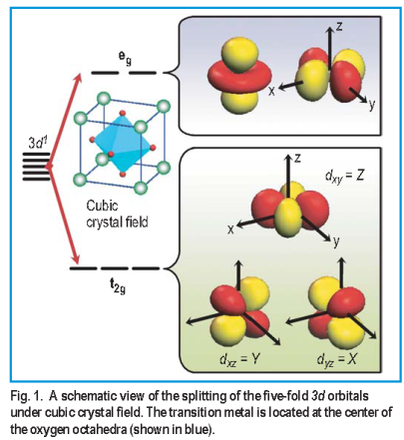

Slide 29
اثارة³A₁g | اثارة ³T₁g | اثارة ³T₂g | سكون ³T₁g

Slide 30
The Crystal Field Splitting of Russell-Saunders terms in high spin octahedral crystal fields.
Russell-Saunders Terms | Crystal Field Components
S (1) | A_{1g}
P (3) | T_{1g}
D (5) | E_{g} , T_{2g}
F (7) | A_{2g} , T_{1g} , T_{2g}
G (9) | A_{1g} , E_{g} , T_{1g} , T_{2g}
H (11) | E_{g} , 2 x T_{1g} , T_{2g}
I (13) | A_{1g} , A_{2g} , E_{g} , T_{1g} , 2 x T_{2g}

Slide 31
The ground term energies for free ions are also affected by the influence of a crystal field and an analogy is made between orbitals and ground terms that are related due to the angular parts of their electron distribution. The effect of a crystal field on different orbitals in an octahedral field environment will cause the d orbitals to split to give t_{2g} and e_{g} subsets and the D ground term states into T_{2g} and E_{g}, (where upper case is used to denote states and lower case orbitals). f orbitals are split to give subsets known as t_{1g}, t_{2g} and a_{2g}. By analogy, the F ground term when split by a crystal field will give states known as T_{1g}, T_{2g}, and A_{2g}. Note that it is important to recognise that the F ground term here refers to states arising from d orbitals and not f orbitals and depending on whether it is in an octahedral or tetrahedral environment the lowest term can be either A_{2g} or T_{1g}.

Slide 32
For splitting in a tetrahedral crystal field the components are similar, except that the symmetry label g (gerade) is absent.
The ground term for first-row transition metal ions is either D, F or S which in high spin octahedral fields gives rise to
A, E or T states. This means that the states are either non-degenerate, doubly degenerate or triply degenerate.

Slide 33
Mulliken Symbols
Mulliken Symbol for atomic and molecular orbitals | Explanation
a | Non-degenerate orbital; symmetric to principal C_{n}
b | Non-degenerate orbital; unsymmetric to principal C_{n}
e | Doubly degenerate orbital
t | Triply degenerate orbital
(subscript) g | Symmetric with respect to center of inversion
(subscript) u | Unsymmetric with respect to center of inversion
(subscript) 1 | Symmetric with respect to C₂ perp. to principal C_{n}
(subscript) 2 | Unsymmetric with respect to C₂ perp. to principal C_{n}
(superscript) ' | Symmetric with respect to s_{h}
(superscript) " | Unsymmetric with respect to s_{h}

Slide 34
Photoelectron Spectra of Atoms (Noble Gases)

Slide 35
²P_{1/2}
²P_{3/2}
Energy
¹S

Slide 36
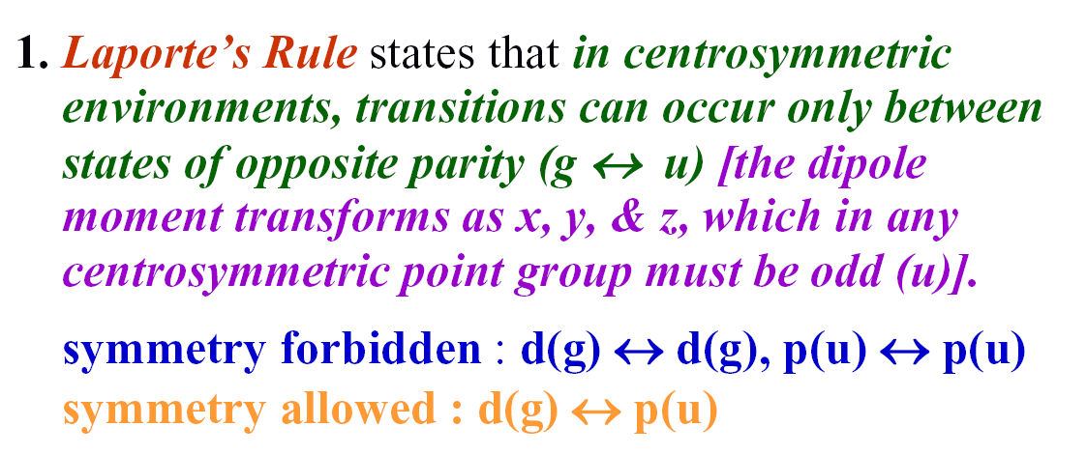

Slide 40
Example
Find the term symbol for the most stable state and the excited state for carbon atom.
Electronic configuration 1s², 2s², 2p²
برمين الى الاسفل بــــــرم متعاكس برمين الى الاعلى

Slide 41
نختار أولا اعلى قيمة ل( L ) واعلى قيمة ترافقها من ( S )وهنا 1+, 1+
نستخرج( 2S+1 )( 2L+1 ) وهنا(3)x(3)=9 يعني تسعة حالات دقيقة مشتقة من هذه
الحالة .
نحذف من الجدول ثلاث حالات ( MS=1)وثلاث حلات عشوائية من MS=0))وثلاث حالات من
( MS=-1).
لما كان (2=L )و( S=1 ) اذن رمز الحالة ( ³P ).
نختار اعلى قيمة ل( L ) واعلى قيمة ترافقها من ( S )من القيم المتبقية بعد الحذف وهنا
(2=L )و ( S=0 ).
نستخرج( 2S+1 )( 2L+1 ) وهنا(5)x(5)=5 يعني خمس حالات دقيقة مشتقة من هذه الحالة .
نحذف من الجدول خمس حالات (MS=0).
لما كان (2=L )و( S=0 ) اذن رمز الحالة ( ¹D ).
نختار اعلى قيمة ل( L ) واعلى قيمة ترافقها من ( S )من القيم المتبقية بعد الحذف وهنا
(0=L )و ( S=0 ).
اذن هنا حالة واحدة لما كان (0=L )و( S=0 ) اذن رمز الحالة ( ¹S ).
يتم ترتيب الحالات حسب طاقاتها (الاقل طاقة ثم الاعلى) ]فالاوطأ طاقة هو الاعلى قيمة
( 2S+1 )واذا تساوت قيم التعددية فالاوطأ طاقة هو الاعلى قيمة ل( L ) .
اذن اصبح التسلسل

Slide 42
The ground state G.S( the most stable state)
See spin multiplicity (2S+1) , the G.S that has the highest value for(2S+1)
For equal values of (2S+1)the G.S that has the highest value for(L).
Select J value as follow:
Maximum J value for more than half-filled subshell i.e[J=L+S].
Minimum J value for less than half-filled subshell i.e[J=L-S].
[J=L], for half-filled subshell, because L=0.
Number of microstates=
Where h = n-e ; e = number of electrons ; n =2 X number of orbitals
For ⁶C(G.S) Number of microstates =
=
=15

Slide 43
Example
Find the term symbol for the most stable state and the excited state for V³⁺, How many microstates included theV³⁺electron configuration ?
Electronic configuration 1s², 2s², 2p⁶, 3s², 3p⁶, 4s⁰, 3d²
Number of microstates =
=
=45
Deriving of Russel-Sounders term symbols according to elimination method

Slide 44
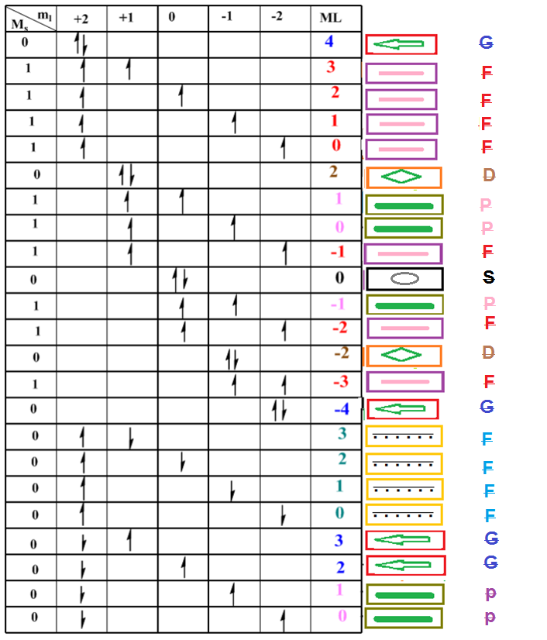
V⁺³
electronic configuration =
1s², 2s², 2p⁶, 3s², 3p⁶, 4s⁰, 3d²

Slide 45
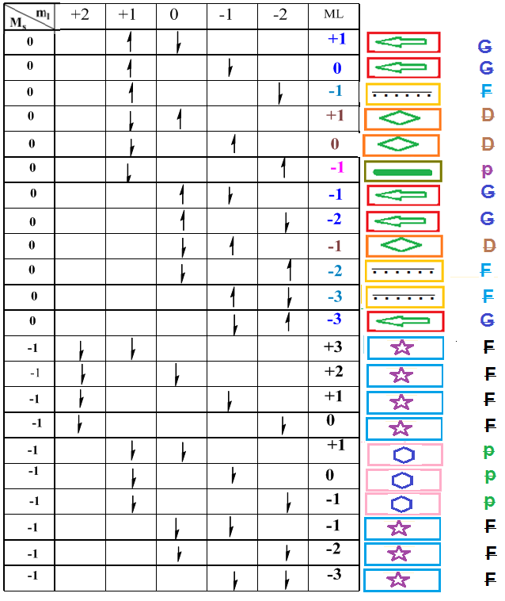
Continue V⁺³
electronic configuration =
1s², 2s², 2p⁶, 3s², 3p⁶, 4s⁰, 3d²

Slide 46
We must discussed first the highestmultiplicity Ms=+1
The first state when ML=3
(2L+1)(2S+1)=(2x3+1)(2x1+1)=21 states
7(Ms=1); 7(Ms=0); 7(Ms=-1)
Second Ms =+1 but ML =1
(2L+1)(2S+1)=(2x1+1)(2x1+1)=9 states
For Ms=0 ML =4
(2L+1)(2S+1)=(2x4+1)(2x0+1)=9 states
For Ms=0 ML =2
(2L+1)(2S+1)=(2x2+1)(2x0+1)=5 states
For Ms=0 ML =0
(2L+1)(2S+1)=(2x0+1)(2x0+1)=1 states

Slide 47
The lowest energy , the most stable state, the state with the highest multiplicity (³F, ³P) , For equal multiplicities, the more stable-state is the state with greater L value ( ³F) and so on.

Slide 49
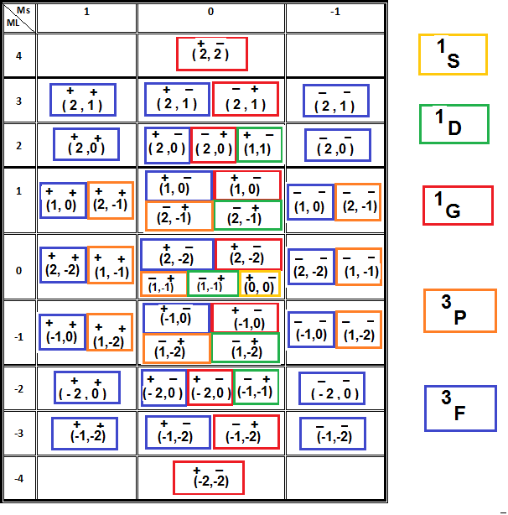
Derive the Russel-Sounders term-symbols using table method

